Slide 1

Time & Attendance System
System Upgrade Plan - Presentation
Prepared by:
Ervin Brosas
ICT Department

Slide 2
Agenda:
Introduction to TAS Upgrade Plan
Key Features
Use Case Diagram
Conceptual Site Map

Slide 3
Introduction:
The Time & Attendance System needs to be upgraded to the latest technology platform due to the following main reasons:
Maintenance and enhancement to the current system is cumbersome due to its limited capabilities.
Source code is not available since the old system was developed using Iron-speed web development tool which is no longer supported.
Performance is an issue because the system was designed using an old technology.
Security setup is not centralized as compared to other AMS .NET systems.
Rendering of reports takes too much time and cannot be exported to other file formats such as Excel, PDF, CSV and RTF
GUI forms are not user-friendly and require proper user training to be able to use the functionalities correctly.
The are several versions of the system which should be consolidated into one software solution and integrate other small and new systems such as Employee Self Service, Employee Directory, Fire Team Tracking and Visitor’s Pass Monitoring System.

Slide 4
Key Features:
The system will be developed using the latest Microsoft .NET technology and will follow the best practices in software development to assure better performance, usability, maintainability and security.
System will be hosted in a centralized web server and will be accessible within GARMCO’s local network only.
GUI forms will be designed to assure ease of use and provide better user interactions.
Security setup will be centralized as implemented with other AMS .NET system. Access to a form, report or particular functionality in the system can be customized based on role or individual user.
Windows Authentication will be used to authenticate users. Login credentials will be fetched from the Windows login account hence no separate login screen is required.
All bugs, issues and system limitations reported by users will be addressed.
All reports can be exported to other file formats such as Excel, PDF, CSV and RTF.
Integrated with other GARMCO systems such as JDE, GAP and Plant Swipe Access System

Slide 5
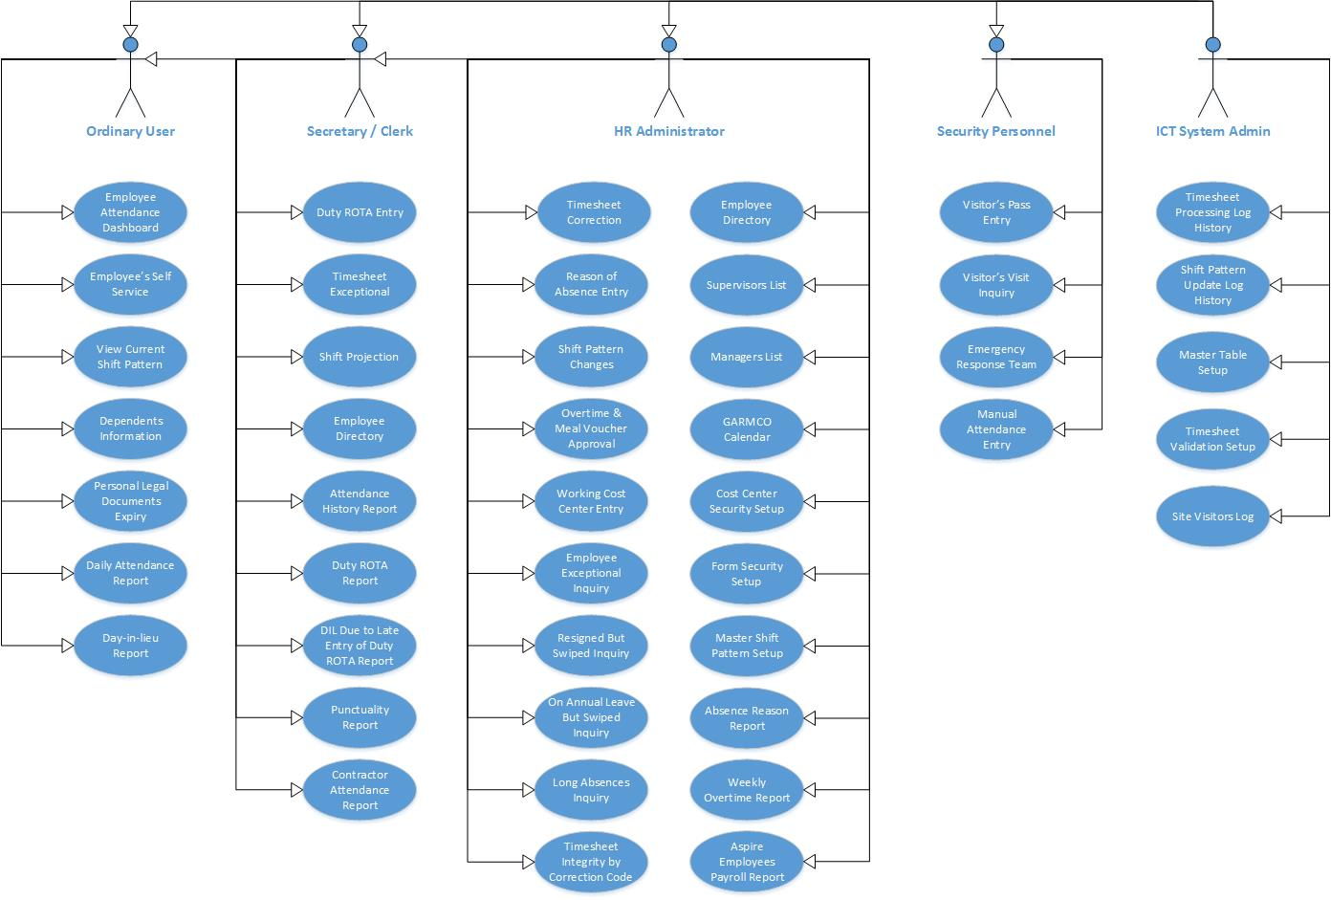
Use Case Diagram

Slide 6
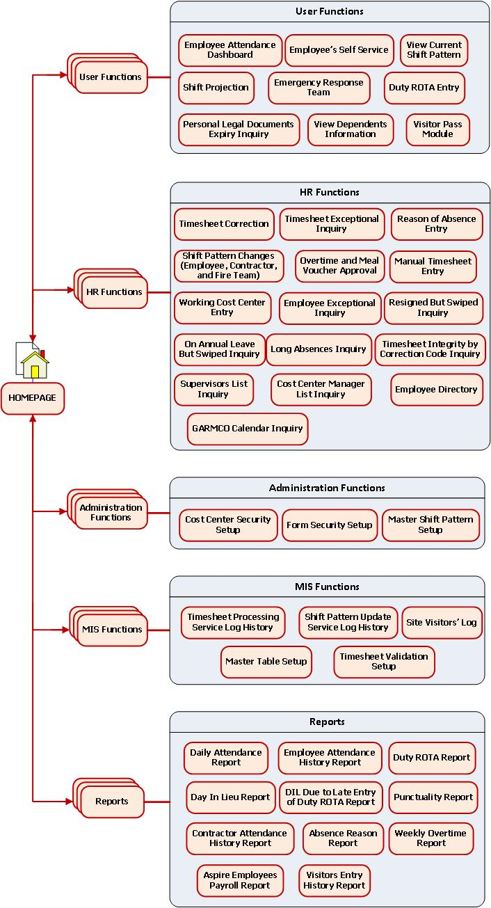
Conceptual Site Map

Slide 7
Thank You!

